Slide 1
OSG use cases for NSDF including XenonNT as an example
Frank Wuerthwein
Director
San Diego Supercomputer Center

Slide 2
Outline
Why focus on the Xenon Collaboration?
Side benefits from the technical work we do there.
More general discussion of OSG use cases.
Where are OSG and NRP going in 2022

Slide 3
XENON Collaboration
A midsize global collaboration has been
operating a sequence of instruments,
deep underground the Gran Sasso mountain
in Italy to detect the dark matter in our galaxy.

Slide 4
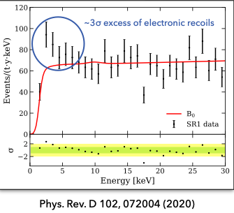
Xenon Program
Two Top cited papers with 1700 and 1500 citations.
7 papers with more than 600 citations. NSF funded world leader in race for discovery against DOE funded
competitor.
Saw 3 sigma excess in last data taking period.
New results will be available within NSDF timeframe.

Slide 5
XenonNT is the best bet on our timeline to have massive science impact

Slide 6
XENON Storage & Processing Challenge
Instrument in Gran Sasso, Italy
Tape Archive in Sweden
Disk storage in 7 locations across Holland, Italy, Israel, France, USA
Compute sites on EGI, OSG, and NSF allocation on Expanse@SDSC
Few PB of data per year.
Dominated by calibrations.

Slide 7
What do we do?
Integrate Qumolo based “Universal Scale Storage” at SDSC into OSG & Xenon data infrastructure.
As read/write top down Rucio controlled storage system with 200TB in support of Xenon science operations on Expanse.
As an origin for the OSG data federation, to allow anybody who has data in USS@SDSC to use that data via OSG.
As a cache for OSG science on Expanse, and especially the $2M Expanse supplement for PATh.
This scratches 3 strategic itches of NSF and OSG

Slide 8
An Aside on OSG and PRP/NRP

Slide 9
Status Today
OSG and PRP operate open infrastructures that any researcher affiliated with any US science program can join their resources to.
These infrastructures interoperate.
Let’s start with the most established:
Compute Federation of OSG
Data Federation of OSG

Slide 10
Federation = distributed control
Resource owners determine policy of use for what they own.
Implies policy is set locally at the resource.
Resource consumers determine policy of what they are willing to use.
Implies policy is set locally at the user access point.
Federated system matches consumers to owners respecting both sets of policies.

Slide 11
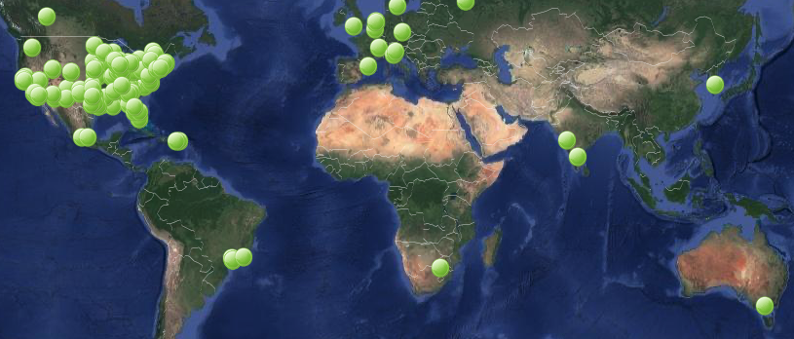
OSG Compute Federation
More than 100 clusters registered directly in OSG.
An additional couple hundred accessible via partners.
Each green dot is a compute cluster
registered with OSG

Slide 12
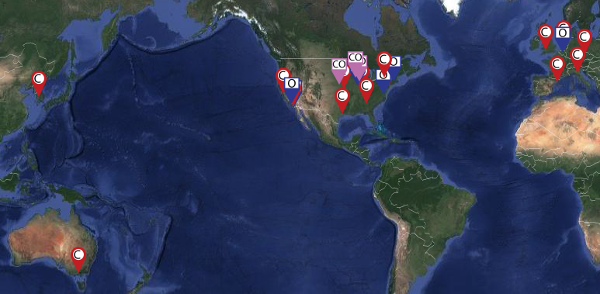
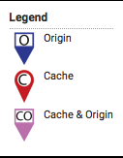
OSG Data Federation
18 Caches in 4 continents … 6 in R&E network backbone
9 Data Origins in 2 continents … both public and private
Data owners integrate their data on their storage
or transfer their data to public storage

Slide 13
Long Term Vision
Create an Open National Cyberinfrastructure that allows the federation of CI at all ~4,000 accredited, degree granting higher education institutions, non-profit research institutions, and national laboratories.
Open Science
Open Data
Open Source
Open Infrastructure
Open Compute
Open Storage & CDN
Open devices/instruments/IoT, …?
Openness for an Open Society

Slide 14
3 Ways to build Open Infrastructure Federation(s)
At the container orchestration layer, e.g. K8S as implemented in Pacific Research Platform.
Federating independent container orchestration frameworks, e.g. via SLATE or via Admiralty on K8S.
Federating storage and compute clusters at the storage and batch system layer., e.g. via OSG.
More cybersecurity control
implies more effort to join & operate.
Some Institutions will never be able to join because of a mismatch
between the effort they have and the cybersecurity they desire.

Slide 15
The OSG Data Story
In 2020, we saw
for the first time many individual Researchers
with larger than TB data sets,
even one with a 100TB data set.
Large Data no longer just a feature of
large collaborations in physics and astronomy.

Slide 16
Modalities of Data Use
Science that produces data.
Small input large output
Science that processes data once.
Large input small output
Science that reuses the same data over and over.
We will show some examples for each,
with pointers to more information.

Slide 17
1. Producing 400TB on OSG
Multiple telescopes allow measurement of direction via triangulation
Simulation Chain:
Challenge: measure sources extensions that are 1/10th of
the size of intrinsic resolution.
=> excellent simulations required.
Nepomuk Otte presentation @ OSG AHM 2020

Slide 18
2. Analyzing O(PB) on OSG
SPT-3G: 12,000 detectors sampled at 1502Hz
Collecting >TB/day of data.
Challenge: turn RAW data into CMB map of sky.
Slice data in GB chunks per job.
Run many many jobs.
Roughly 5-10 Million CPU hours per science paper
Next gen CMB instrument in late 2020 will collect ~70TB/day of data.
Nathan Whitehorn @ OSG AHM 2020

Slide 19
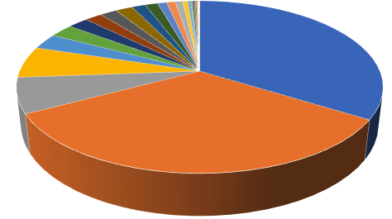
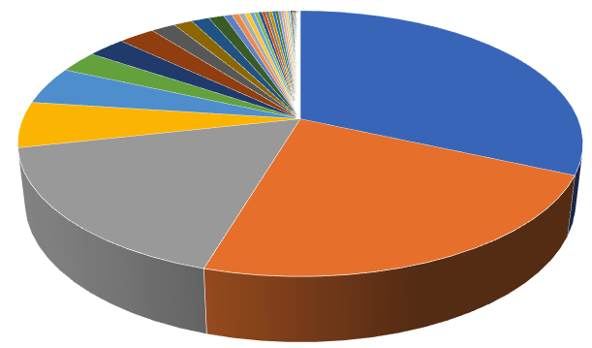
3. About 100 Projects used the caching infrastructure in 2020
Average data reuse ~ 100 times
Projects with largest Working Sets
are not the most read, or reused data
New in 2020:
More individual researchers !!!
Read Volume
Working sets
22 PB
212 TB
Projects with largest working sets
Projects with largest reuse
Owner | Working Set | Data Read | Reuse
Npavlovikj (UNL) | 110 TB | 346 TB | 3.1
LIGO (Private) | 46 TB | 6.9 PB | 152
CHTC | 11 TB | 380 TB | 34
elagin | 5.4 TB | 8.1 TB | 1.5
tuxino | 5.2 TB | 6.3 TB | 1.2
LIGO (Public) | 7.8 TB | 1.9 PB | 243
runyu | 3.4 TB | 5.3 TB | 1.6
gladstein | 2.1 TB | 3.7 TB | 1.7
Owner | Working Set | Data Read | Reuse
Nova | 370 GB | 7.0 PB | 20,000
gziegler | 24 GB | 280 TB | 12,000
odgerk | 113 GB | 630 TB | 5,700
Dune | 33 GB | 161 TB | 5,000
cgomes02 | 100 GB | 385 TB | 4,000
SBND | 100 GB | 203 TB | 1,300
MicroBoone | 412 GB | 385 TB | 950
Minerva | 600 GB | 450 TB | 780
(ignored projects with working sets smaller than 10 GB)

Slide 20
Wide Range of Sciences use the caching infrastructure
Bioinformatics (npavlonikj)
Evolutionary Biology (gladstein)
Plant Genetics (gziegler)
Computer Engineering (cgomes02)
Instrumentation R&D (elagin, runyu, odgerk, tuxino)
Experiments in (Astro)Physics (LIGO, Nova, Dune, SBND, MicroBoone, Minerva)
Projects with largest working sets
Projects with largest reuse
Owner | Working Set | Data Read | Reuse
Npavlovikj (UNL) | 110 TB | 346 TB | 3.1
LIGO (Private) | 46 TB | 6.9 PB | 152
CHTC | 11 TB | 380 TB | 34
elagin | 5.4 TB | 8.1 TB | 1.5
tuxino | 5.2 TB | 6.3 TB | 1.2
LIGO (Public) | 7.8 TB | 1.9 PB | 243
runyu | 3.4 TB | 5.3 TB | 1.6
gladstein | 2.1 TB | 3.7 TB | 1.7
Owner | Working Set | Data Read | Reuse
Nova | 370 GB | 7.0 PB | 20,000
gziegler | 24 GB | 280 TB | 12,000
odgerk | 113 GB | 630 TB | 5,700
Dune | 33 GB | 161 TB | 5,000
cgomes02 | 100 GB | 385 TB | 4,000
SBND | 100 GB | 203 TB | 1,300
MicroBoone | 412 GB | 385 TB | 950
Minerva | 600 GB | 450 TB | 780
(ignored projects with working sets smaller than 10 GB)

Slide 21
How you can join
Compute Resources:
You can join your entire cluster via a “Hosted Compute Entrypoint”
Multiple batch systems are supported (SLURM, PBS, HTCondor, …)
You can join an individual compute node by joining the PRP Nautilus cluster.
You can join your K8S cluster via Admiralty federation
You can join the commercial cloud resources you rent
Data Resources:
You can join your filesystem, or part of it (read-only)
You can join your storage via HTTPS (read/write)
You can join your storage node into NRP regional Ceph pools
You can add a cache
Access Point:
You can join your HTCondor submission point
Even such that your schedd submits to both your local HTCondor cluster and OSG

Slide 22
Conceptual Model for Data
Dual homed K8S server
Your filesystem behind your institutional firewall
Access Data on OSG
Compute Federation
Mount
OSG Data
Federation
Institutional
Science DMZ
Institutional Firewall
Your fileserver with your data is behind your institutional firewall.
A dual homed K8S server mounts only those filesystems you want to export.
We operate the OSG Data Federation API by deploying container into K8S.

Slide 23
Flexibility you have
Part of Filesystem can be read-only mount.
Can be shared globally or only with your friends
Another part can be open for writes, and thus authenticated for writes from you and your friends.
Areas you write into can be exported for future processing.
Namespace of your data independent of your server
You can replicate your data to another server, and then delete it on your server to regain space.
E.g. you can mv your data from your private server to LIGOs public server without changing the namespace how people access it. I.e. jobs before and after access the data via the same names.

Slide 24
Where we are going

Slide 25
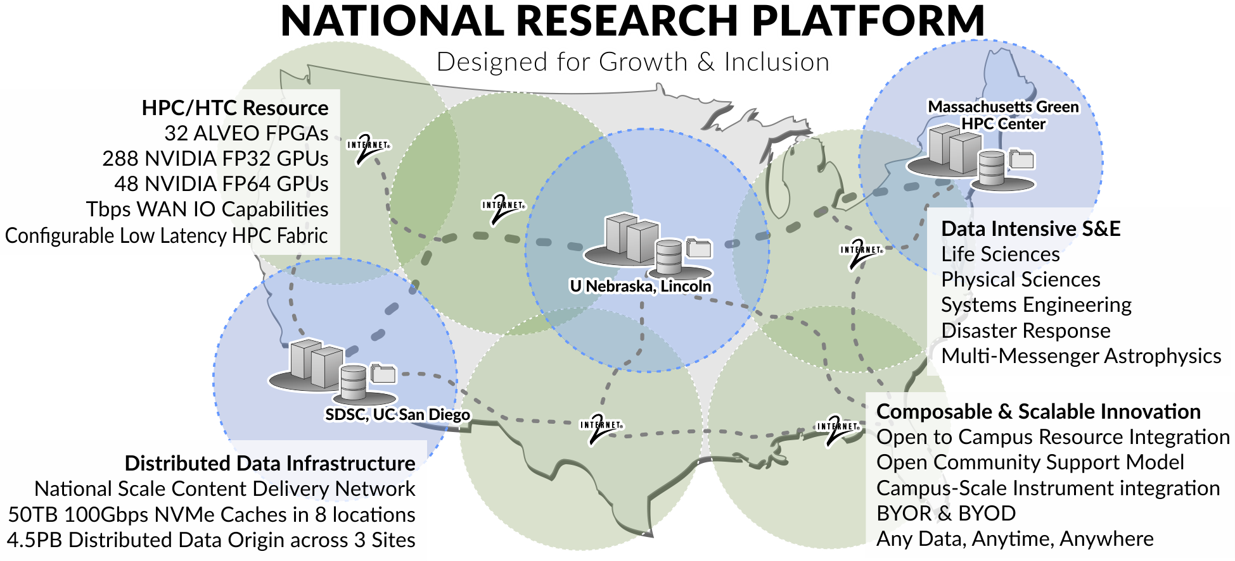
Prototype National Research Platform
Nationally Distributed Category-II System (NSF)
3 year prototyping phase followed by 2 year allocation phase.
Funded as NSF 2112167

Slide 26
Federation Model and Status
Support regional Ceph storage systems across the USA.
Campuses can join individual storage hosts to the Ceph system in their region.
All regional storage systems are Origins in Data Federation
Deploy replication system such that researchers can decide what part of their namespace should be in which regional storage.
Deploy caches in Internet2 backbone such that no campus nationwide is more than 500 miles from a cache.
We have enough hardware funded via multiple different NSF projects to deploy nationwide in 2022.
We have the software stack in production to allow any campus in the USA to join the open infrastructure.
We are lacking effort to scale support nationwide.
I’d like NSDF to benefit from all of this by being interoperable.

Slide 27

Acknowledgements
We gratefully acknowledge the NSF support via NSF 2112167, 2030508, 1841530, 2120019, 2100237, 1541349, 1540112.

